Slide 1

Declining fertility and policy responses in Latin America
KIPF/HAPI Conference
Fiscal and Tax Reform: Policy Responses for
Low Fertility and Aging Society
Honolulu, April 2024
Rafael Rofman
CIPPEC

Slide 2
Fertility trends in Latin America
A (very short) history of population policies in the región
Policy responses in recent years
Medium term challenges
Conclusions
Contents

Slide 3
Latin America as a region has been considered to be in a moderate transition path.
By 2000, TFR was around 2.5, and a smooth decline was expected, to reach replacement level by 2020.
However, something happened in the last decade in several countries…
Fertility trends
-33,2%
-29,7%
-27,5%

Slide 4
What happened?
Not completely clear: Probably some social/cultural changes, but introduction of birth control implants seems to have had a critical role
Decline is even more important among teenagers: In Uruguay, under-20 fertility dropped by 55% in 6 years, in Argentina, by 62% in 8 years.
These changes produced a dramatic shift: fertility in Argentina declined faster in six years than in the previous six decades.
Interestingly, policymakers (even those working on population or social areas) are only now beginning to notice, and are not sure whether this is good or bad…
Fertility trends

Slide 5
Population policies in Latin America have been driven by geopolitics:
In the late 19th and early 20th Century: Attract western european migrants.
Second half of the 20th Century: Territorial focus, growing concerns with emigration (“Brain drain”)
Political tensions: High fertility was considered positive by some (geopolitical), negative by others (neo-Malthusians).
Slow shift towards more liberal, rights-based view in recent decades as gender equity became relevant.
Environment concerns are present but with little impact in actual policies.
Population policies

Slide 6
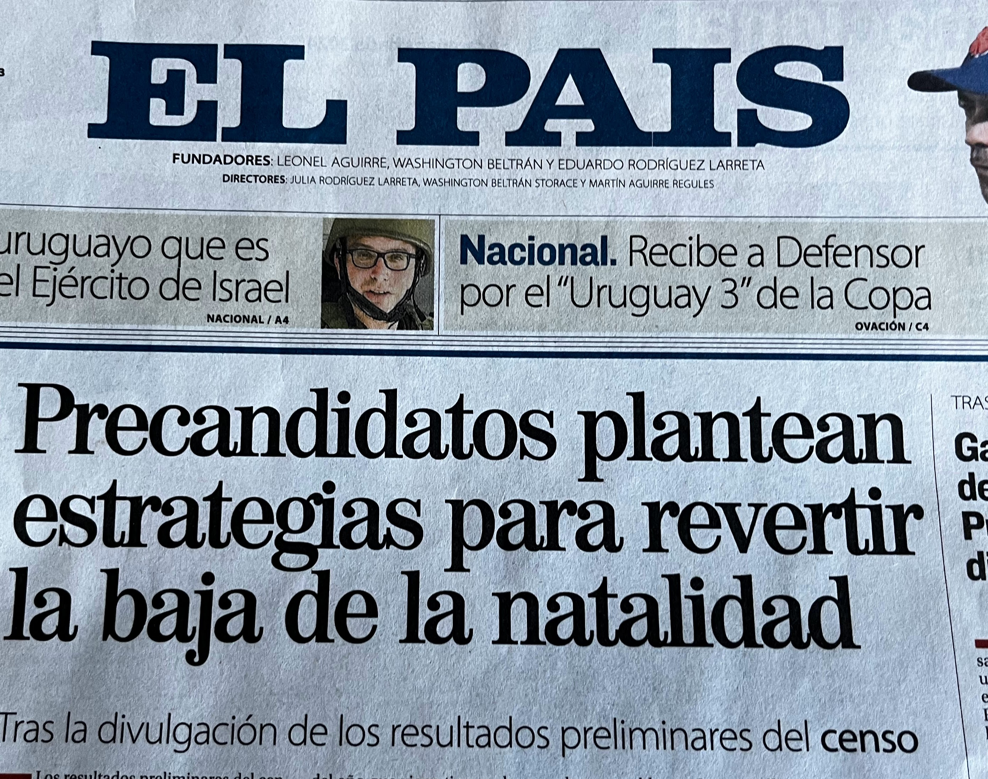


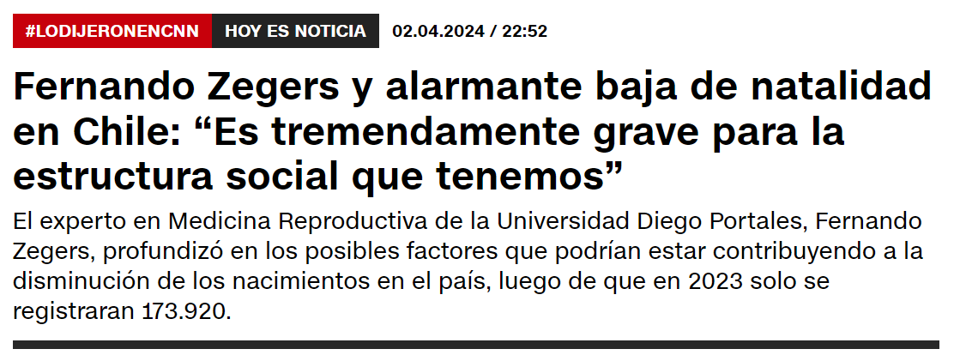
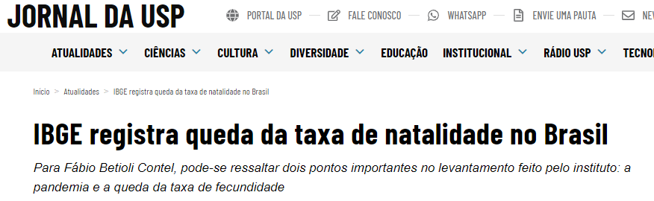
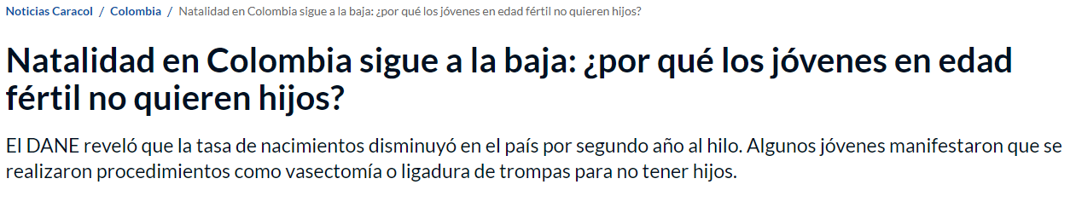

The new climate
Population policies

Slide 7
Concerns are not about geopolitics anymore, but about aging, pensions, depopulation
In most cases the situation is seen as a risk:
“ How will we finance social security?”
“Will the country depopulate in the medium term?”
“Who will produce goods and services in the future?”
“Are we going the way of Japan and Korea?”
Very little discussion about opportunities
Population policies

Slide 8
Focus on pension reforms:
Higher retirement ages
Lower benefits
Limitations (albeit not elimination) for exceptions
Some policy responses
Brazil 2019
Uruguay
2022
Argentina
2024?
But others are moving in the opposite direction:
Expand coverage without additional financing
Increase benefits
Weaken financial sustainability of current schemes
Mexico
2019-2020
Peru
Colombia (in congress)
Chile
2024?

Slide 9
- Most countries are in the peak of the demographic bonus
- Opportunities have increased with recent changes, but these are just opportunities…
What about the médium term?

Slide 10
We know that growing productivity is critical, but…
What about the médium term?

Slide 11
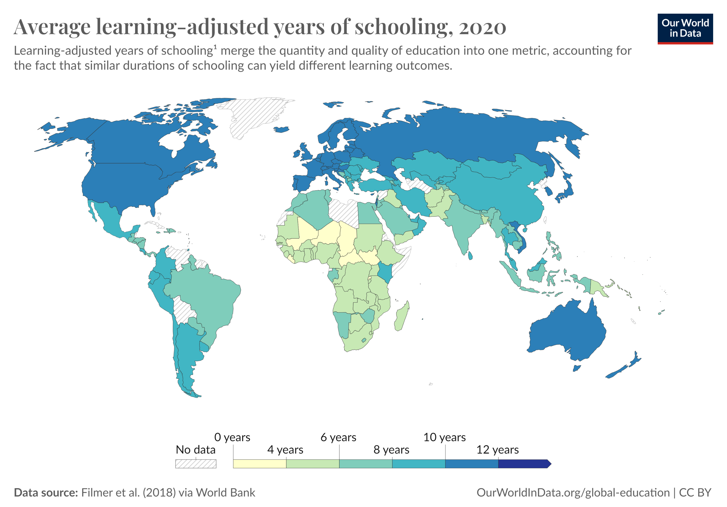
and education is critical for productivity growth…
What about the médium term?

Slide 12
What should we do?
In Argentina, the number of new elementary school students declined by 35% in five years
That means:
Smaller classrooms?
More extended schooldays?
Taking teachers out of the front line to retrain?
Take time to redesign teachers training programs?
Instead, policymakers are talking about:
Building more schools
teachers´ salaries
Protecting retirement program for teachers
What about the médium term?

Slide 13
Fertility decline is happening (and faster than expected)
Positive reaction in terms of individual rights, but seriously lacking on economic and social trends
Limited acknowledgment by policymakers
Policy reforms debate around pension systems
No focus on medium term, productivity or education shortfalls
Politics tend to be more short-term than ever, creating a serious challenge
In conclusion

